Slide 1
Loose Attempts at a Course Recommendation
Through Unintentional Email Hoarding

Slide 2
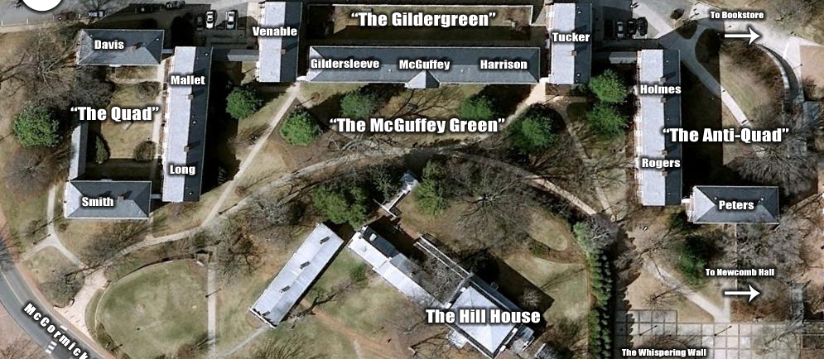
Weird Buildings Full of Emails

Slide 3


Slide 4
General Process
Download a whole lot of emails
Process them in R using the Text Mining package and the Text Mining E-mail plug-in

Slide 5
General Process
Use regular expression to filter for just emails with Course Mnemonics in the email body or subject line
This means emails that only refer to classes by name or by professor were lost.
Something that could be improved on later using Lou’s List.

Slide 6
Some Analyses
findAssocs(emailse.tdm,"favorite",.80)
professors | 0.90
economics | 0.88
micro | 0.87
hysterical | 0.88
anthropology | 0.85
english | 0.85
shakespeare | 0.85
tragedies | 0.84
harumpf. | 0.84
circus-related | 0.83
spanish | 0.81

Slide 7
Some Analyses
findAssocs(emails.tdm,"worst",.60)
beating | 0.67
genetics. | 0.67
hated | 0.67
honor. | 0.67
microbiology | 0.67
professor | 0.67

Slide 8
General Process
Moved to Python and used the TextBlob package, built on top of the NLTK and pattern packages, for further processing and sentiment analysis etc.

Slide 9
Unfortunately
The bcchat email corpus ended up being pretty thin, and did not play nicely with any classifiers.

Slide 10
Remember…
Sentiment(classification='pos', p_pos=0.9949862702675312, p_neg=0.005013729732467834)]
Unless you have strange views on soul-robbing, I disagree.

Slide 11
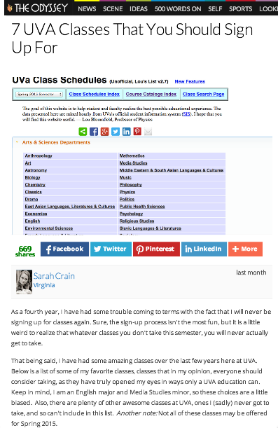
So I looked for other, more easily classifiable sources
A blog post, 7 UVA Classes that You Should Sign Up For

Slide 12
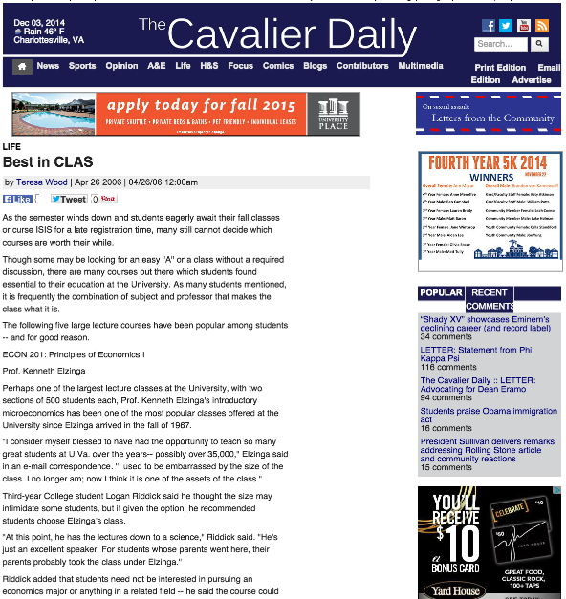
So I looked for other, more easily classifiable sources
Cavalier Daily Articles, including “Best in CLAS”

Slide 13
So I looked for other, more easily classifiable sources
Lots of “I forget the course number…”
Also, sexually explicit phrasing to describe classes.
Reddit – No Good.

Slide 14
A few other issues
Many Cavalier Daily articles included professors talking about their own classes.
Also, a lot on ENWRs and Special Topics classes that are not reoccurring
See: Data Hacking
And no real examples of negative opinions in these articles, so not much help with classifier.

Slide 15


Slide 16
Future Considerations
Find/create a better classifier for the bcchat emails
Maybe based on a twitter corpus?
More colloquial language
More general chatter about “classes”
Use Lou’s List to better match course names and professor names to mnemenomics.

